Slide 1
Correlation of O3 and NO2 in Hessen
Matthias Lochmann, HLNUG

Slide 2
Impressum
All measurement data in this document is available from https://www.hlnug.de/messwerte/datenportal/luftmessnetz. The analysis is maintained at https://github.com/Ma-Loma/Antikor.git and was performed by Matthias Lochmann (HLNUG) on 2025-04-02.

Slide 3
Motivation
The next slide is a screenshot of the burden-eu webinar with title “Establishing new exposure-response functions for air pollutants and environmental noise”: the results of different metaanalyses on NO2 and relative risk of COPD. The natural cubic spline method without constraints might indicate a negative slope. As it is likely, that O3 increases the risk of COPD, this might be due to the (anti)correlation of NO2 with O3 (via complex pathways of air chemistry).

Slide 4
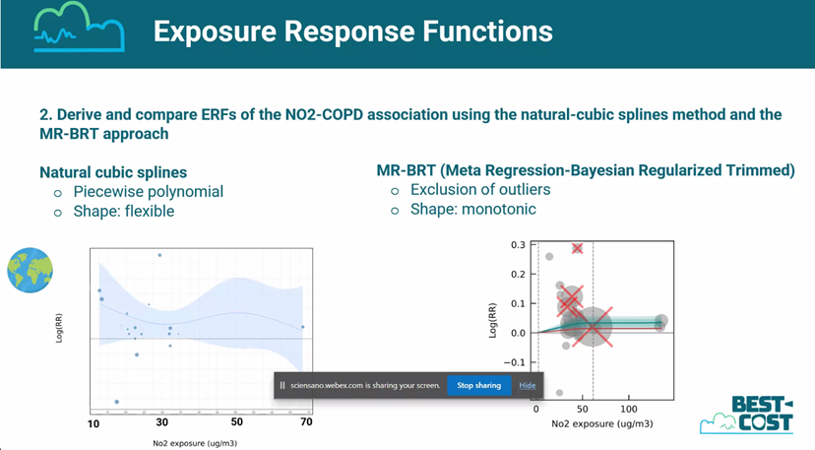

Slide 5
Measurements from Hessen
This presentation will show the observed correlation of NO2 and O3 in Hessen (Germany). The next graph shows the annual averages of measured NO2 and O3 concentrations since 2005. The measurement site categories are symbolized as different colors. O3 is measured at all “Rural Background” sites, at most “Urban Background” sites, but not at “Urban Traffic” sites.

Slide 6
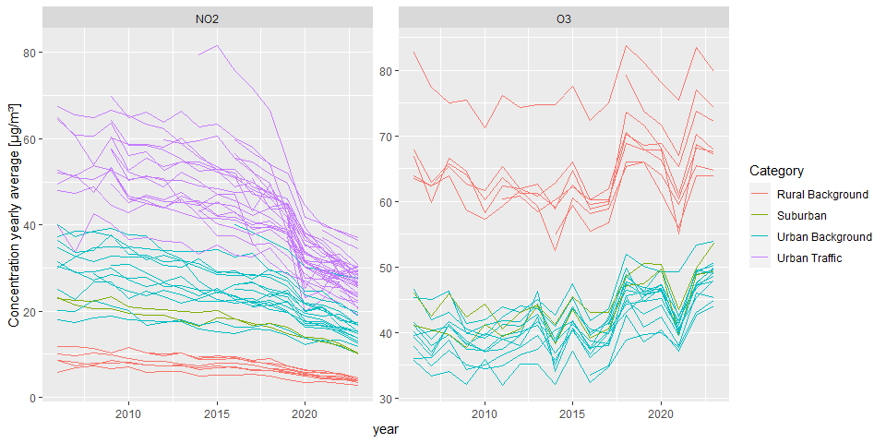
NO2 and O3 yearly averages

Slide 7
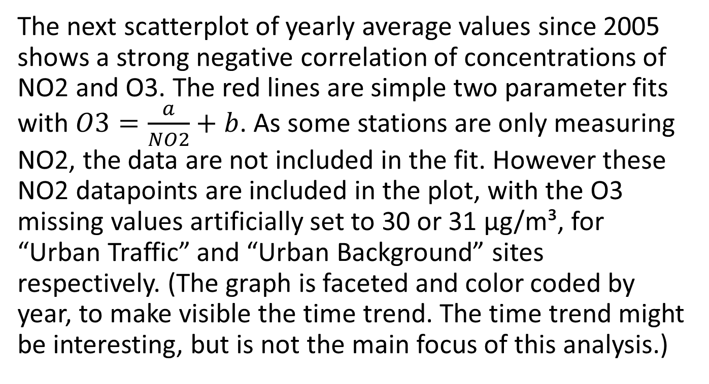
Correlation of NO2 and O3
The next scatterplot of yearly average values since 2005 shows a strong negative correlation of concentrations of NO2 and O3. The red lines are simple two parameter fits with $O3=\frac{a}{NO2}+b$. As some stations are only measuring NO2, the data are not included in the fit. However these NO2 datapoints are included in the plot, with the O3 missing values artificially set to 30 or 31 µg/m³, for “Urban Traffic” and “Urban Background” sites respectively. (The graph is faceted and color coded by year, to make visible the time trend. The time trend might be interesting, but is not the main focus of this analysis.)

Slide 8
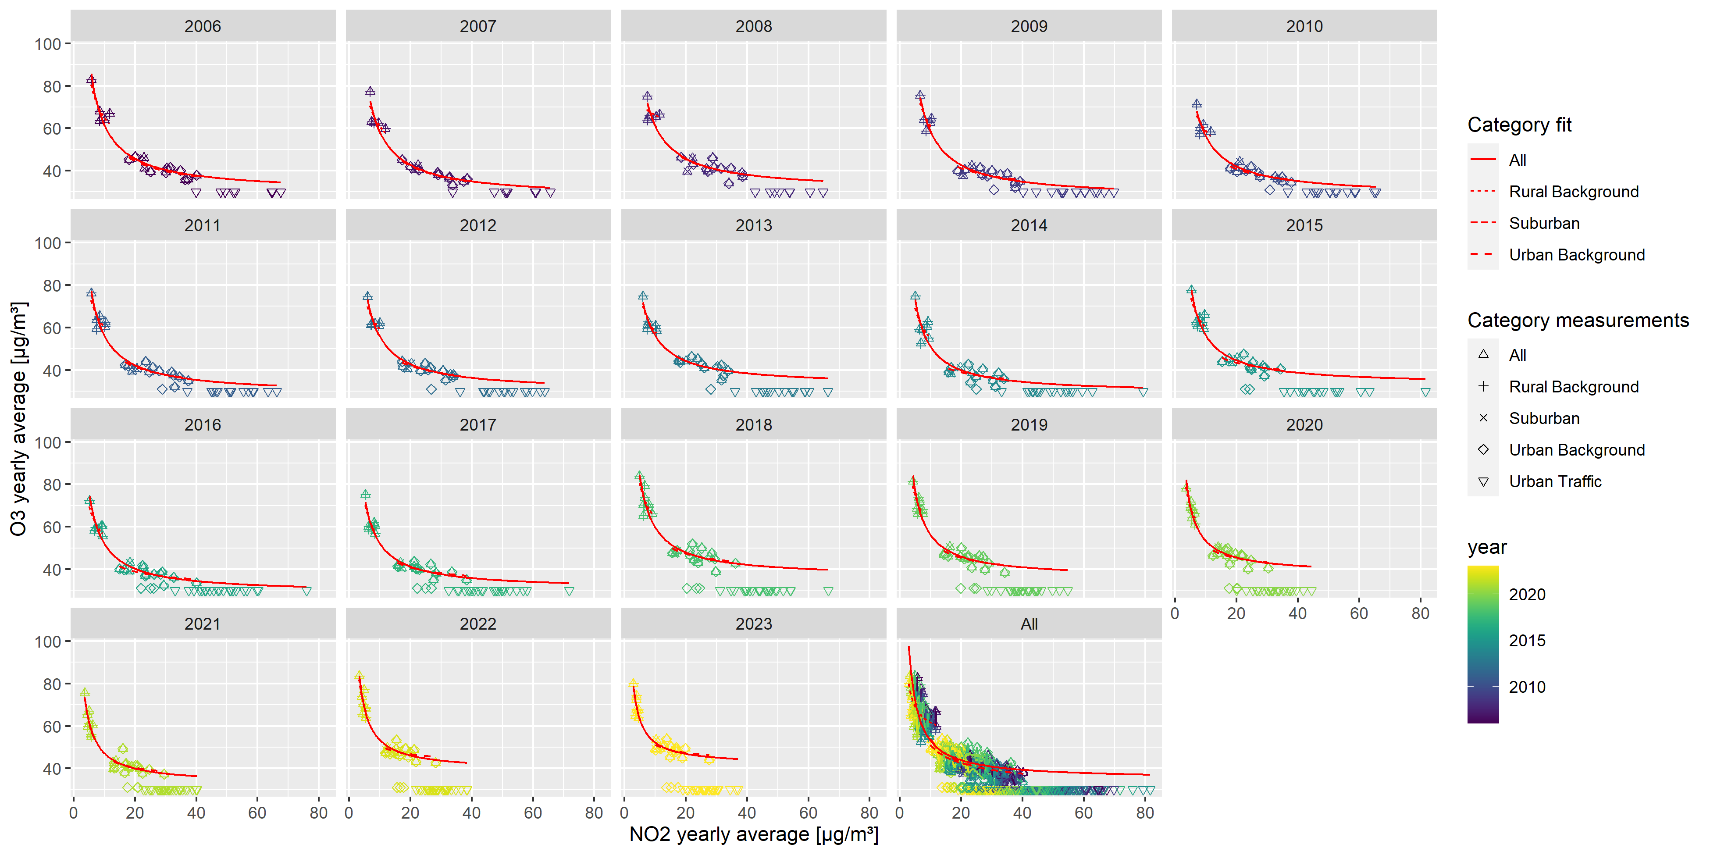
Correlation of NO2 and O3

Slide 9
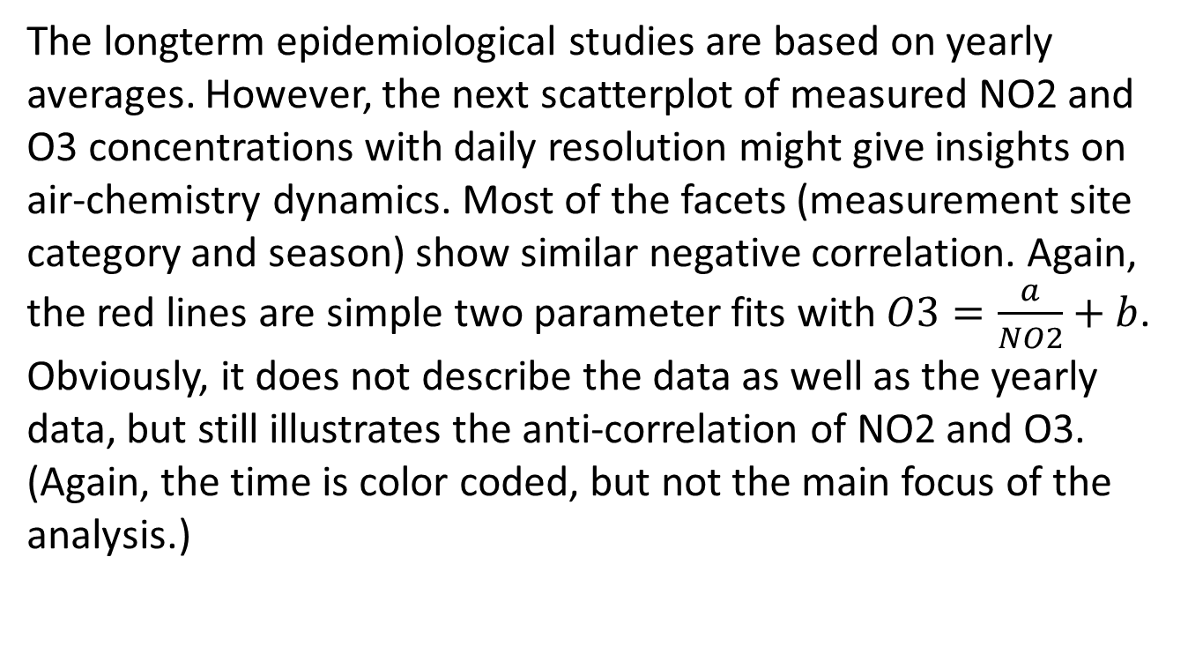
Daily resolution
The longterm epidemiological studies are based on yearly averages. However, the next scatterplot of measured NO2 and O3 concentrations with daily resolution might give insights on air-chemistry dynamics. Most of the facets (measurement site category and season) show similar negative correlation. Again, the red lines are simple two parameter fits with $O3=\frac{a}{NO2}+b$. Obviously, it does not describe the data as well as the yearly data, but still illustrates the anti-correlation of NO2 and O3. (Again, the time is color coded, but not the main focus of the analysis.)

Slide 10
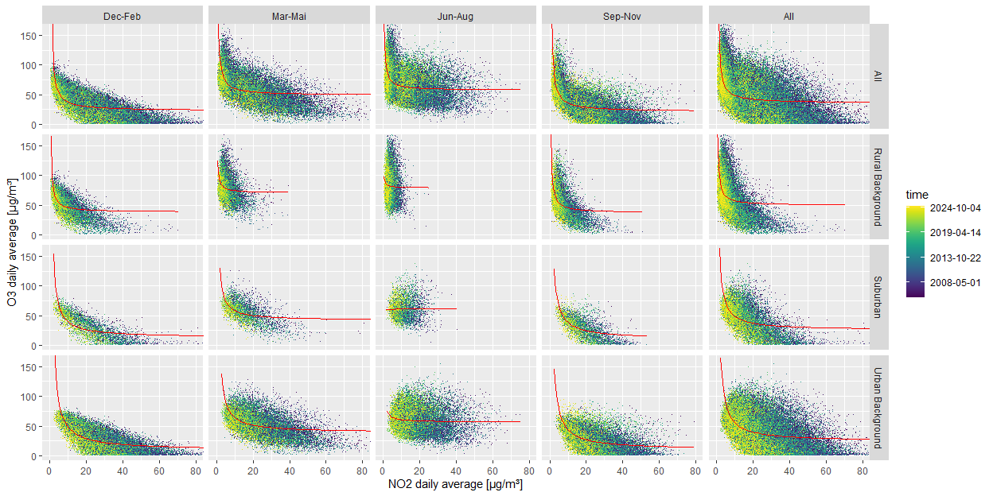
Daily resolution

Slide 11
Conclusion
The analysed data consists only of measurement data from Hessen, Germany and does not include O3 measurements at urban traffic sites. However, the observed anticorrelation might be representative for other regions with similar climate and emission patterns.
Most probably, there might be a truly protective effects of NO2 via the complex pathways of air chemistry to effectively reduce O3. The possibly negative slope of relative risk of COPD as a function of NO2 (when using natural cubic spline method) is not necessarily wrong, when using a single pollutant model without adjustment for the possible confounder O3.

Slide 12
Thinking about counterfactual models
When considering a re-analysis of the epidemiological data, it might be worth to consider, which counterfactual model to use.
single pollutant model, with counterfactual scenario NO2 concentration=0 or NO2 concentration=TMREL, but with O3 unchanged. This might be the classical epidemiological approach, however unrealistic, as O3 concentration would increase in most real world scenarios.

Slide 13
Counterfactual model with two pollutants
single pollutant model, with counterfactual scenario NO2 concentration=0 or NO2 concentration=TMREL, with rising O3 concentration. This might be a more realistic scenario, implicitly used in the analysed performed so far. However, the ERF should then be allowed to have a negative slope.
two pollutant model, with counterfactual scenario both NO2 and O3 concentration=0 or TMREL. This might be the most beautiful, however most unrealistic scenario.

